Slide 1
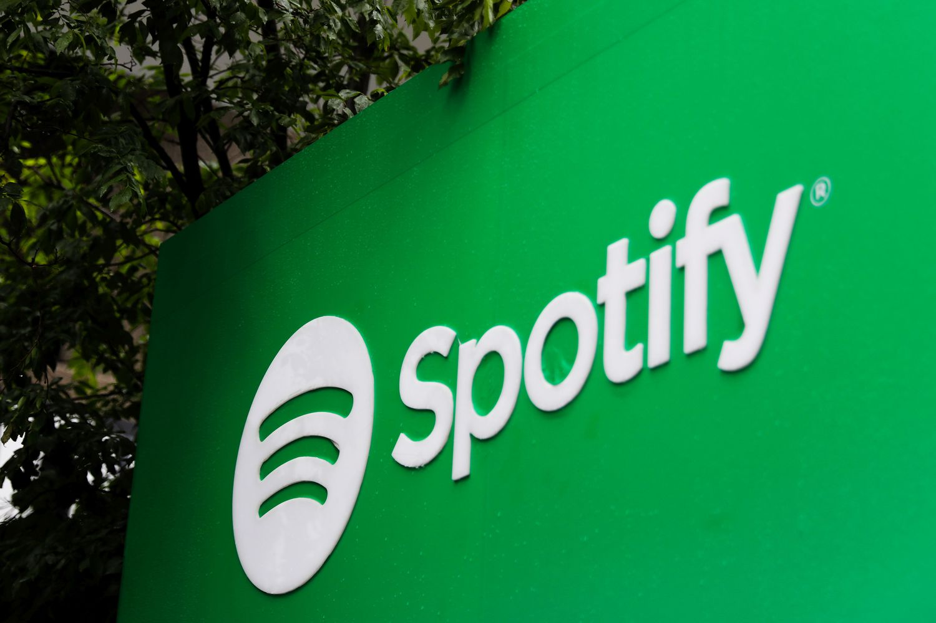
Presented by: Saloni Shahi Submitted to: Alok Shivhare Sir

Slide 2


1
Introduction to Spotify
2
Mission & Vision of the Dashboard
3
Overview of the Dataset
4
Overview of the Dashboard
5
Key Insights from the Dashboard
Suggestions for Spotify’s Growth
6
7
Reference

Slide 3

Spotify is one of the world's largest music streaming platforms, launched on 23 April, 2006.
Offers access to millions of songs, albums, podcasts, and playlists globally.
Serves as a platform for artists to share and monetize their music
Provides personalized listening experiences using AI-driven recommendations.

Slide 4
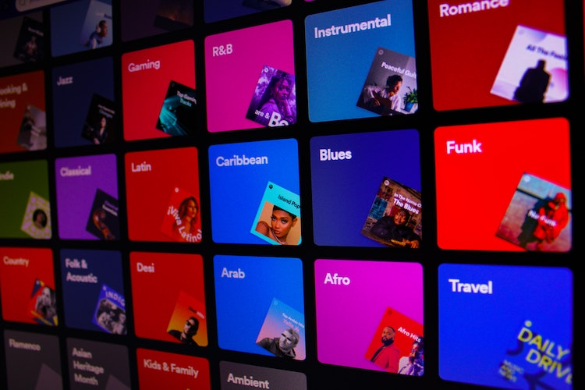



To use data insights to improve Spotify's user experience, help artists grow, and enhance content strategies for global and local audiences.
To analyze Spotify’s extensive track data and provide actionable insights into listener preferences, track performance, and content trends.
Vision
Mission

Slide 5

Dataset click to view dataset

Slide 6


Slide 7
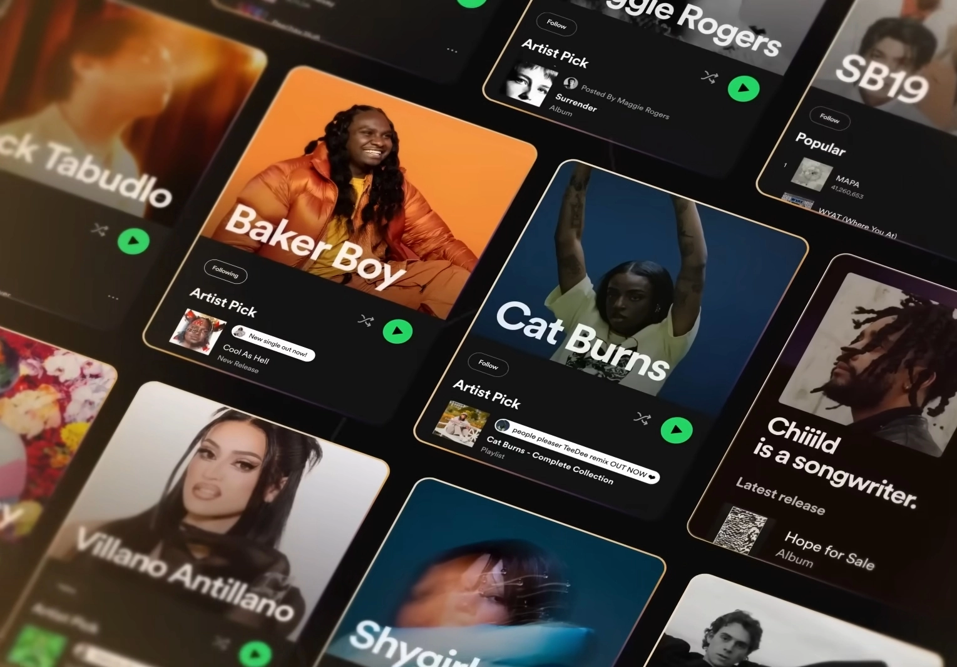
Conclusion
Key Insights:
Popular Content: The album “Big Dawgs” and artist “The Chainsmokers, Coldplay” dominate track performance.
Track Distribution: Most tracks fall in the 0–10 popularity range; only a small fraction exceeds 90.
Language Trends: Tamil dominates track distribution, followed by English and Hindi.
Mood & Tempo: Higher preference for bright tones, moderate valence, and tempos between 80–120 BPM.
Suggestions for Spotify:
Expand Content Localization: Given the dominance of Tamil tracks, invest in regional languages to capture diverse audiences.
Increase Discovery: Enhance discoverability of lesser-known tracks to diversify user engagement.
Focus on Personalization: Refine AI recommendations for niche genres and preferences.
Support for Artists: Provide actionable insights to artists for creating content aligned with popular trends.

Slide 8
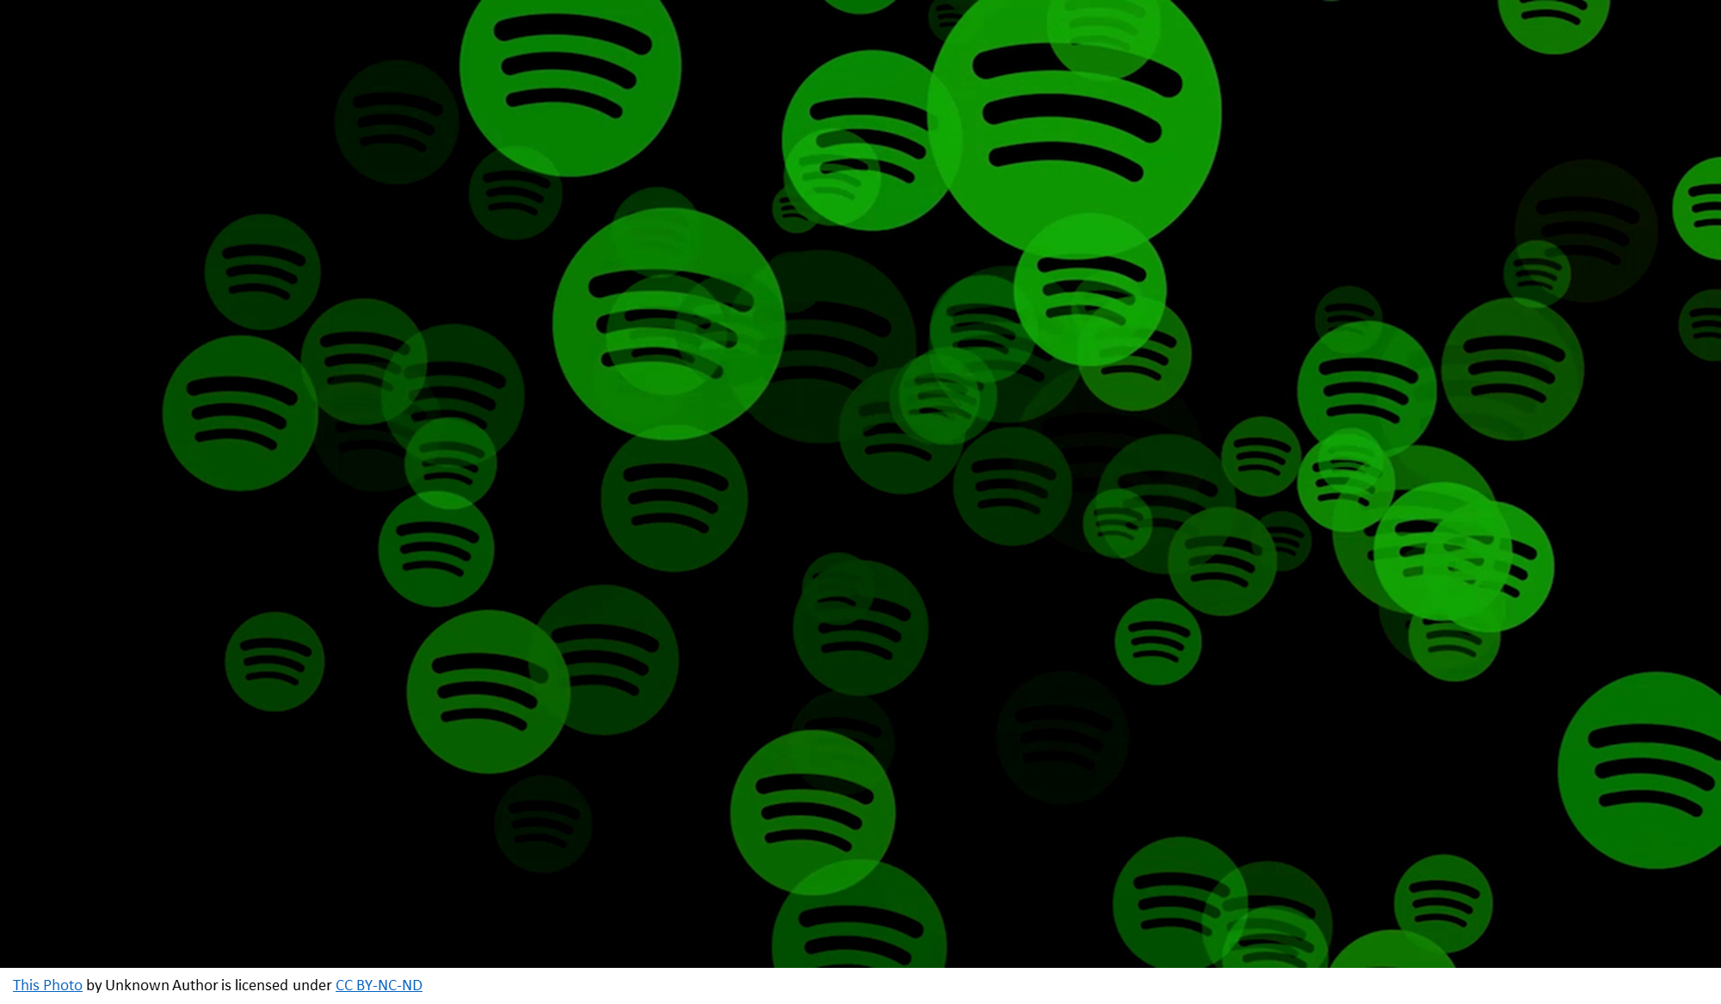

Reference
Dataset: Kaggle
Scan to view the Dashboard

